Slide 1
Sales Optimization Strategy
Minyeong Han
e-mail: minyeonghan17@gmail.com

Slide 2
Customer Problem
How to best optimize the sales efforts for an international dental software company to expand business into the US market
1. Which state should be the starting point for its marketing software in the US?
2. Which aspects of software functionality should be emphasized?
3.What is the main marketing channel and where should the company focus its sales effort?

Slide 3
Findings Which US states have the most dentists?
1. District of Columbia: 104.45 per 100,000 population
2. Massachusetts: 78.18 per 100,000 population
3. Hawaii: 77.49 per 100,000 population
4. New Jersey: 77.41 per 100,000 population
5. Alaska: 76.29 per 100,000 population
9. Maryland:70.90 per 100,000 populations
* Average value from 2001 to 2018. (6. California, 7. New York)

Slide 4
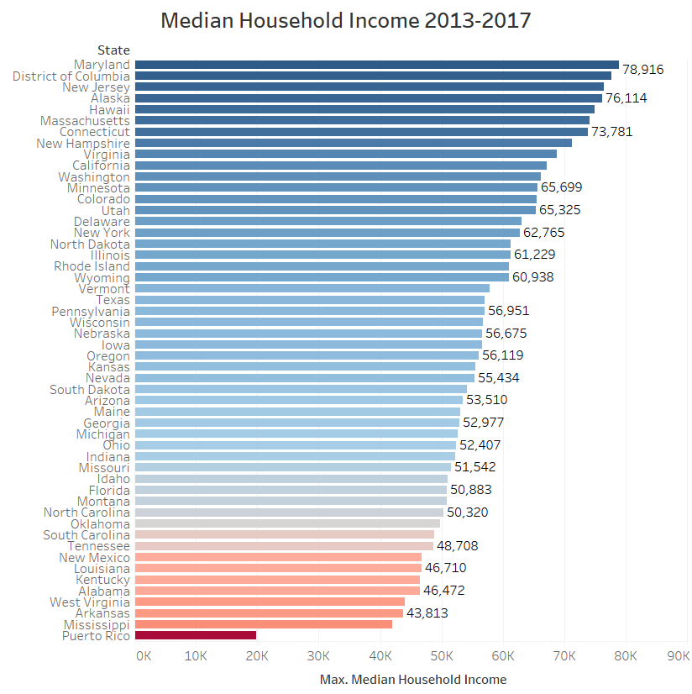
Findings Which states are wealthiest?
Top five wealthy States
Maryland
District of Columbia
New Jersey
Alaska
Hawaii
Massachusetts
* Median household income from 2013 to 2017. (10. California, 16. New York)
Bottom five wealthy states
Puerto Rico
Mississippi
Arkansas
West Virginia
Alabama

Slide 5
Findings What are the top five practice areas?
1. General Practice: 145,118
2. Orthodontics and Dentofacial Orthopedics: 9,992 (cosmetic dentistry)
3. Oral and Maxillofacial Surgery: 6,909
4. Pediatric Dentistry: 5,897
5. Periodontics: 5,364
* Average value from 2001 to 2018.

Slide 6
Sales Optimization Strategy
Tableau dashboard

Slide 7
Recommendations
Target state determination: dentist supply and income level match. Start marketing in the states that have the most dentists per 100,000 people; these states are also among the wealthiest in the US.
Use targeted advertising, conferences, and sales calls to emphasize the cosmetic dentistry functionality in wealthy states.
Emphasize the appointment/administrative software functionality in less affluent states. In these states, there are more patients with longer wait-times. My customer has applied this recommendation and now is developing a custom appointment/administrative version of the software at a lower price point.

Slide 8
Summary
Start marketing in the wealthy states that also have the most dentists per 100,000 people, emphasizing the cosmetic dentistry functionality of the software.
Marketing channel: dental trade shows & conferences

Slide 9
Appendix Recommended conferences
(1) American Dental Association Dental Meeting (ADA Dental Show), September 5-7, Moscone Center, San Francisco, California. (2) American Association of Oral and Maxillofacial Surgeons - 101st Annual Meeting Scientific Sessions & Exhibition, September 16-21, Boston Convention and Exhibition Center, Boston, Massachusetts. (3) Greater New York Dental Meeting, November 29-Deember 4, Jacob K. Javits Convention Center, New York, New York. (4) American Association of Oral and Maxillofacial Surgeons, December 5-7, Sheraton Grand, Chicago, Illinois.

Slide 10
Discussion
Feedbacks or suggestions?

